Slide 1
THE 2024 EDITION
SJU QUIZZERS
MAGISTER
AN ANNUAL SOLO QUIZZING CHAMPIONSHIP

Slide 2
Setters
Avinash T N
Prithwiraj Mukherjee
Rijul Ballal
Venkataraman Ravindra
Rohit Ravichandran
Nadika N
Arul Mani

Slide 3
Section One
Rules
15 questions x 1 point
Stake +1 or +2 for equal negatives

Slide 4
01.
The Vummidi Bangaru Jewellers was in limelight due to a certain ‘symbol’ they were connected to seven decades ago which made a re-entry last year. Consisting of three parts, topped by a Nandi, the middle portion is engraved with motifs of Goddess Lakshmi. The last portion, an elongated stem, is engraved with the images of Kodimaram, a sacred tree indicating fertility.
ID the object which shot to prominence despite people debating the use of this symbol.

Slide 5
02.
The name of this TV channel is not nonsensical as commonly assumed but was named after a type of theater that existed in the US in the 1900’s. These theaters got their name after the admission fee they charged.
What TV Channel?

Slide 6
03.
X was invented after an animal feed manufacturer in Wisconsin changed their machine cleaning technique. Whenever their corn grinder clogged, they poured moist ground up corn to unclog the machine.
When the machine got too hot the moist corn would puff up and form tube like curls. What was invented here?

Slide 7
04.
They were originally known as the Whoop-Ass girls and their designs were inspired by painter Marget Keanes. Who are they?

Slide 8
04.

Slide 9
05.
The rules for naming were devised by X’s founder, who had dyslexia and had trouble remembering the order of numbers in item codes.
A designer explained that X has a crack team to come up with product names, who assign names from a database of words. Bookcases are named after professional occupations or boys’ names. Rugs are named after cities and towns around the region where X is based at, while bed sheets, comforters and pillowcases are named after flowers and plants.
Identify X.

Slide 10
06.
Kirsty Paterson, who has been branded the "sad X" on social media has been shocked by the reaction. “When we took the job we had no idea what we were walking into.” Kirsty said to the BBC that she was able to see the funny side of it now but felt she had to speak out to show the person behind the green wig.
What infamous event designed by images from AI had brought worldwide fame to an experience inspired by a fictional character?

Slide 11
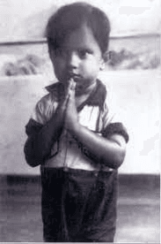
07. One point
Of his name, he says his father originally wanted him to be called Ayyadurai, in honour of the two leaders of the Dravidian Self Respect Movement. But at a public meeting in 1953, to condole the death of another world leader, his father declared the name we all now know him by. Identify?

Slide 12
08.
In 2009, self-described “guerilla ethnomusicologist” Christopher Kirkley was touring the Sahel and western Africa. Despite the lack of recording studios, he found that the ‘desert blues’ music of people like Abdallah Oumbadougou, Mdou Moctar, El Wali etc., was widely being listened to and shared by people, thanks to a device that was then being widely adopted.
What devices?

Slide 13
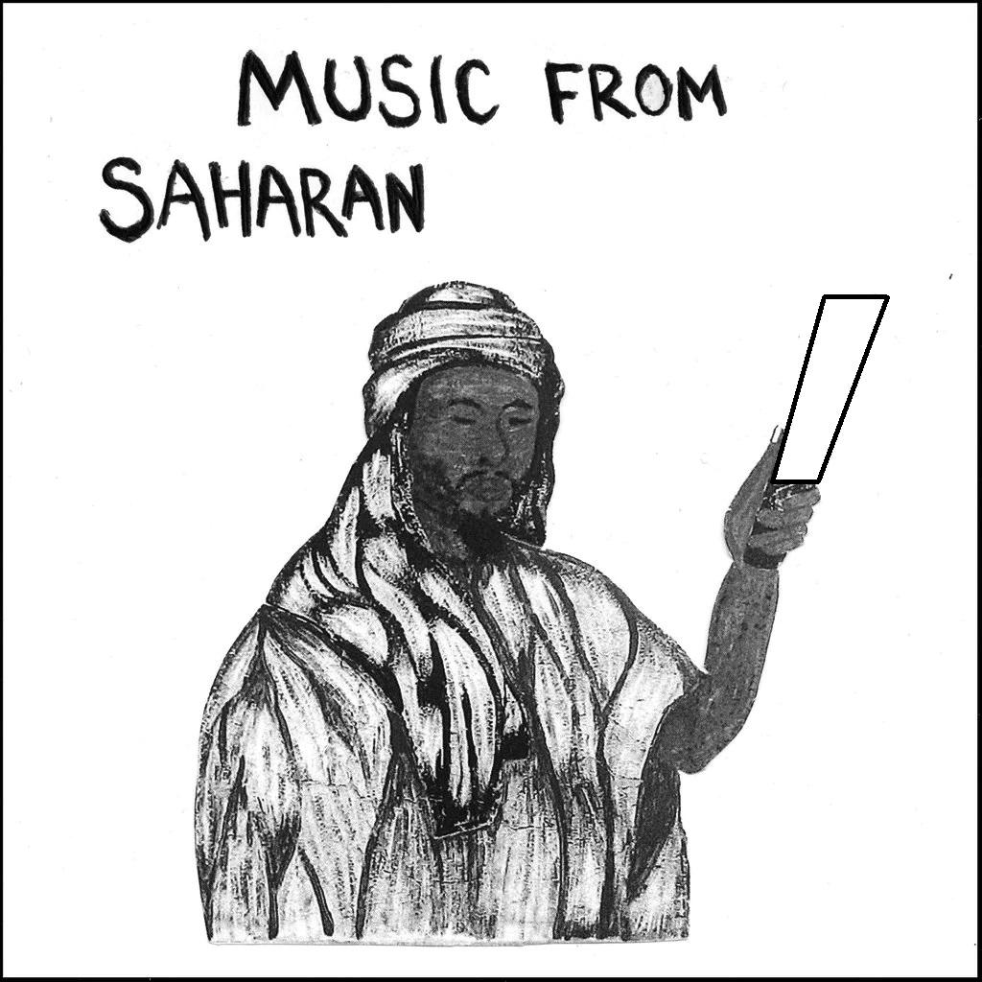

Slide 14
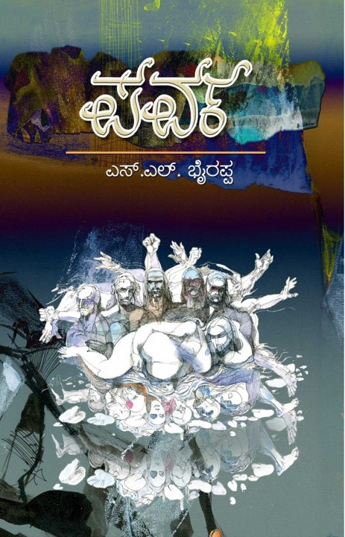
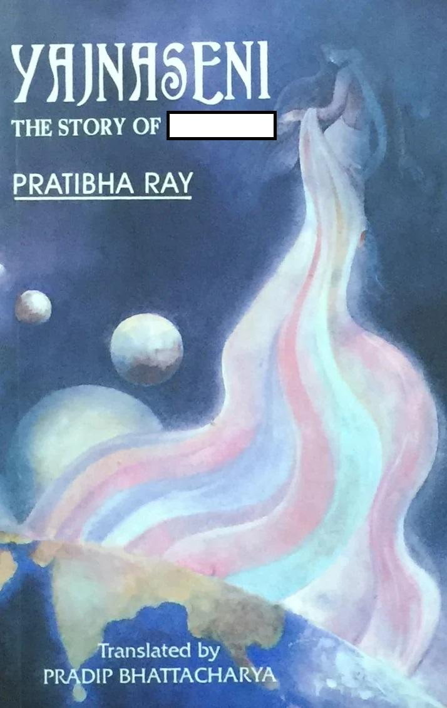
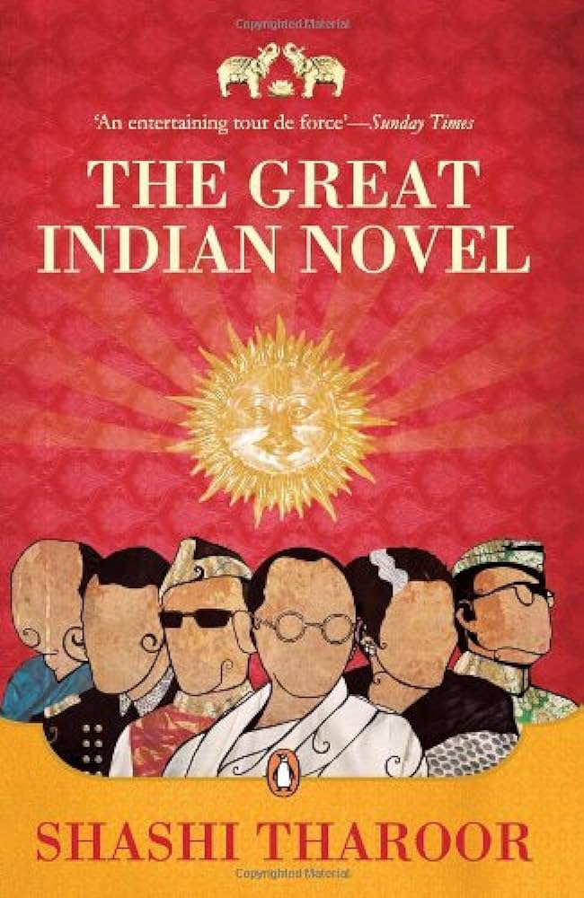
09.
Three modern novels based on which epic?

Slide 15
10.
MS Golwalkar, the 2nd chief of the RSS disapproved of the Indian flag saying that “the tricolour would be inauspicious for the Nation, as Hindu religion considers the number 3 to be inauspicious”.
In response, this titan of the freedom struggle remarked “What to say about a person who does not understand that there are only 3 main gods in Hindu religion - Brahma, Vishnu & Shiva?”
Who was this person?

Slide 16
11.
Packaged drinking water brand commemorating (!!) a momentous act of civil resistance led by a future law minister of India that occurred 97 years ago in Raigad district, Maharashtra.
What incident?

Slide 17
12.
One theory says that this happens as these animals use moonlight to navigate & therefore get confused, another that it is because they move in a particular direction to escape danger.
We now have a more compelling answer: these animals evolved to tilt their back to wherever is brightest; for hundreds of millions of years, this was the night sky, and this behaviour told them which way was up. Humans have changed the environment increasingly, leading to catastrophic results.
What behaviour, one that refers to an irresistible & dangerous attraction?

Slide 18
13.
You will often seen bottles of pink solution in photos of Anti-Corruption Bureau sting operations. ACB officials provide the complainant with currency notes smeared with a colourless powder. When the money has changed hands, ACB officials swoop in and get the corrupt official to dip their fingers in bottles filled with basic sodium carbonate solution. If it turns pink, it proves that the official took the bribe.
What substance, familiar to all school chemistry students, is used to catch one pink-handed?

Slide 19
14.
Sergei Krikalev (in photo) and Alexandr Volkvo have been dubbed the “last citizens of the Soviet Union.”
What did they do, or what happened for them to be described thus?

Slide 20
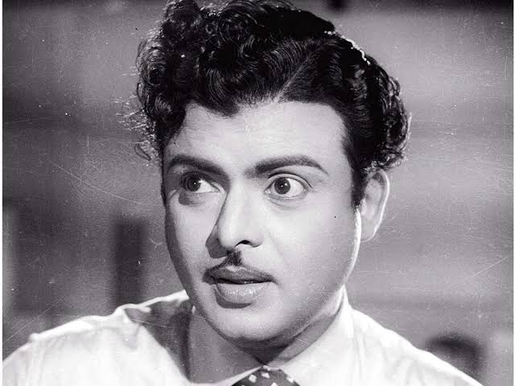
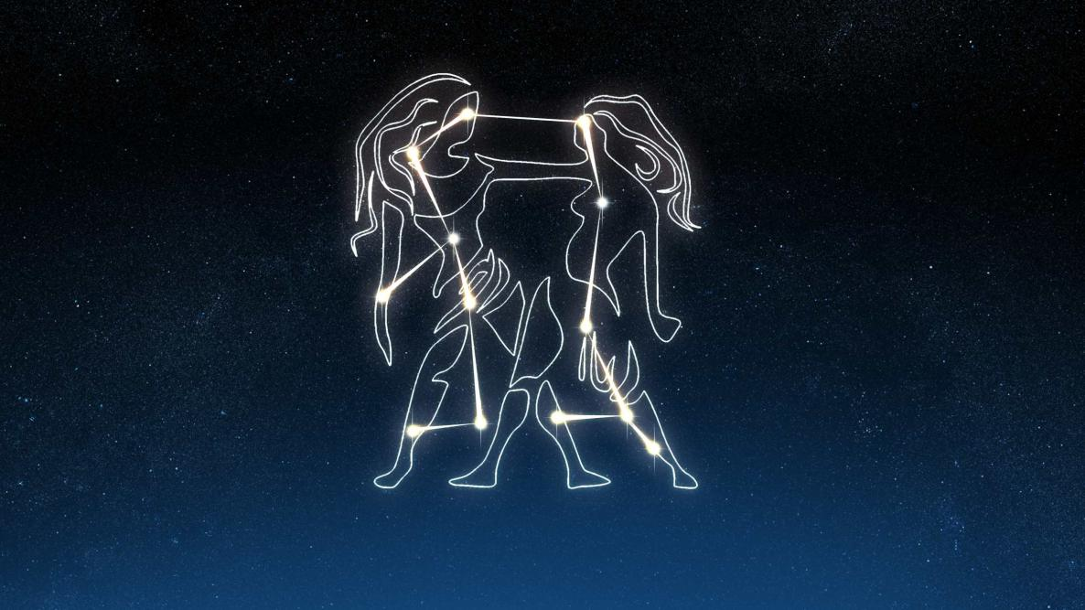
15.
Connect (one word) the pictures to a Google product that was previously called “Bard”.

Slide 21
Section Two
Rules
20 questions x 1 points

Slide 22
16.
You could call it a form of social distancing since one of its benefits is disease control.
What two word term suggesting top level introversion is used for such adaptive behaviour?

Slide 23
17.
Shakespeare Sarani is a major road in Kolkata. It is also one of the very few places in India that got renamed after a British person post-independence (in 1964). The British era name of this road was _______ Road. Fill in the blanks with a common English word that Shakespeare was known for. The old nomenclature was due to the presence of the _______ of Calcutta, a structure that was burned down in a fire in 1839 and never rebuilt.

Slide 24
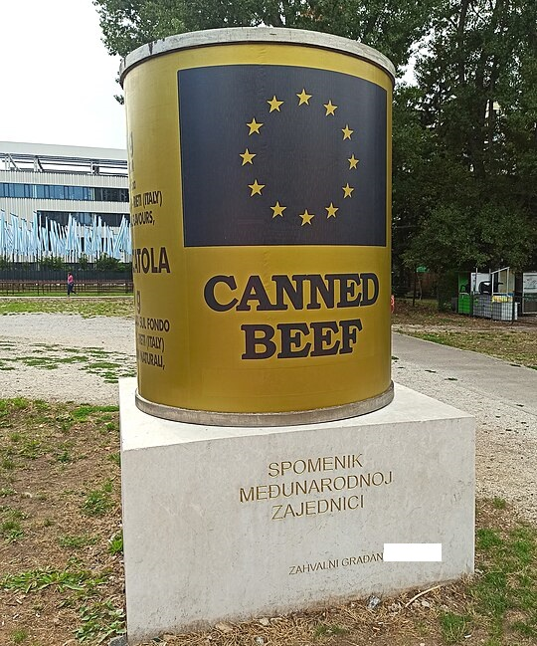
18.
The ICAR Canned Beef Monument has returned to public attention due to the West’s response to Israel’s genocide of Palestinians.
The monument’s creators say their sculpture wasn’t a tribute, as the aid received then was of the wrong kind: barely-edible canned food, including expired food from the Vietnam war, and pork for the half-Muslim country.
In which city will you find this monument?

Slide 25
19.
Zipper and hair are misaligned
Edges of tiles appear repeated
Hair has artificial pattern
Portion of sleeve is missing
The one in bold was spotted first and eventually led to a range of conspiracies and memes. What are we discussing here?

Slide 26
20.
One of the most famous lines in all of literature contains a tricky-to-translate phrase that’s essential to the plot: ungeheuren Ungeziefer. It has no direct translation outside the language.
The word Ungeziefer translates to something like “an unclean animal unfit for sacrifice,” but the phrase is also used by native speakers to describe any kind of repulsive vermin.
Which work is talked about here?

Slide 27
21.
For her role in the Devil wears Prada, Meryl Streep took inspiration from an unlikely figure. As she explained “He never, ever, ever raises his voice and everyone has to lean in to listen, and he is automatically the most powerful person in the room”
Who was she inspired by?
Hint – he later became a mayor of a small town

Slide 28
22.
President Biden recently gave the State of the Union address where he underlined his commitment towards reproductive rights among many other issues. Among the invitees were an Elizabeth Carr as a guest of Senator Tim Kaine of Virginia.
How did Carr become part of medical history in the US?

Slide 29
23.
This newly built house in Kolenchery is designed as a cantilevered structure composed of two volumes that branch out from a central core. The habitable spaces of the residence is above the benchmarked level of 3.2 meters.
What is the reason for setting it above 3.2m?

Slide 30
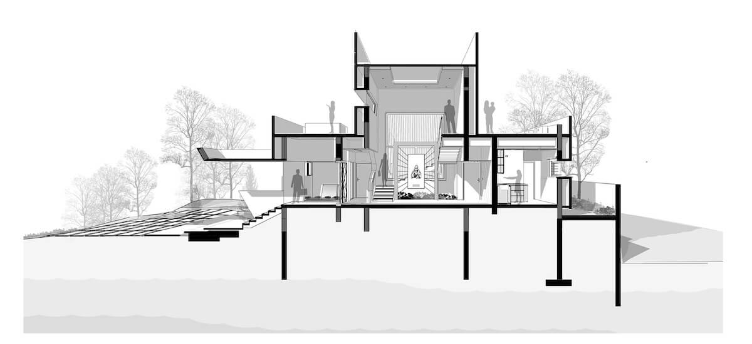
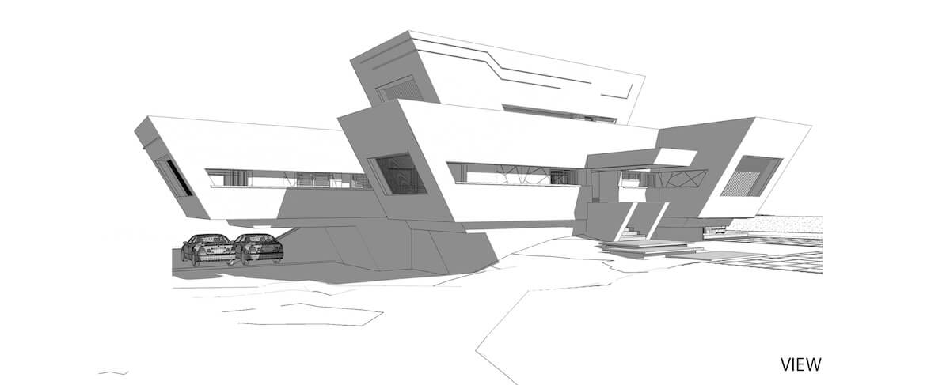
23.

Slide 31
24.
In the picture is college student Zoe and her father Dave. A photo Dave took of Zoe in 2005 spread like wildfire across the world and has helped Zoe earn close to half a million dollars recently. How do we know Zoe better?

Slide 32
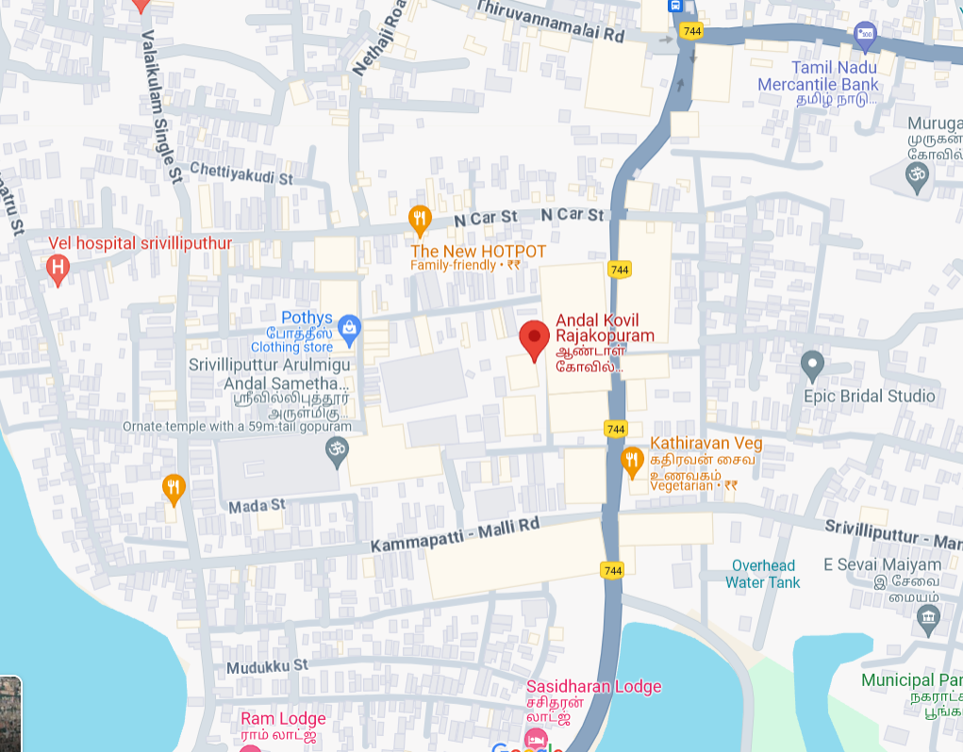
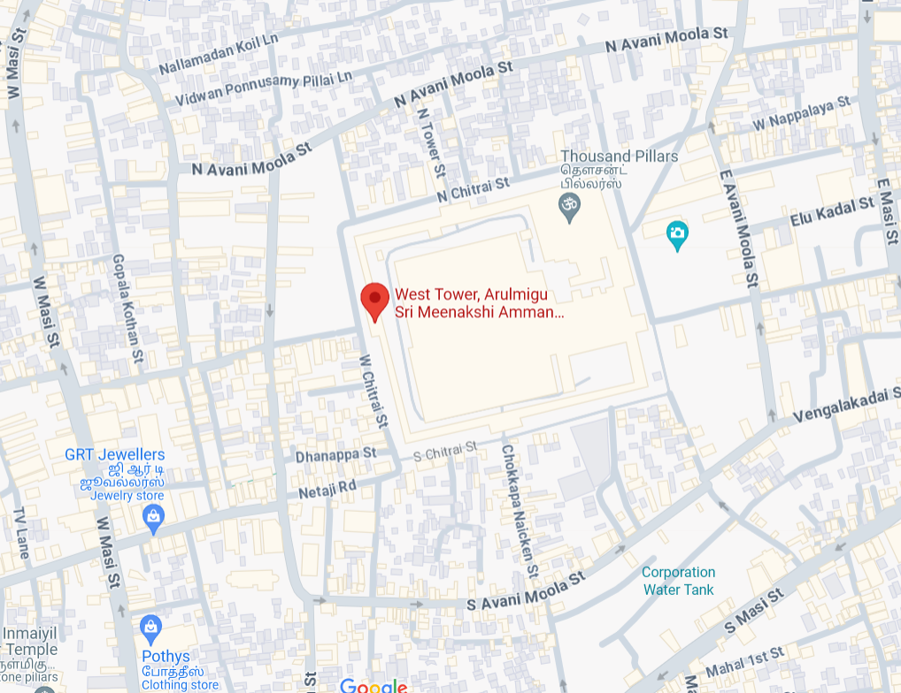
25.
Everybody thinks it is this.
But it is actually this.
What are we talking about here?

Slide 35
26.
What clothing/accessory choices of Dr Who and Good Omens star David Tennant has had people like Graham Linehan, Helen Joyce, Kelly J Keen, amongst other followers of JK Rowling’s twitter account, throw a hissy fit?

Slide 38
27.
Jan 24, 2000 | Jan 13, 1884
Feb 17, 2005 | Feb 06, 1884
Mar 29, 1996 | Mar 01, 1908
The first part of each of these date-pairs break one of the longest-held beliefs about Bengaluru, but the second part perhaps supports it. What respite can you and I, and everyone in this room get, if we know what these date-pairs signify?

Slide 39
28.
In 2020, its centenary year, the Government Science College was upgraded to an university. It was named after a 9th century emperor of the Rashtrakuta dynasty, an accomplished poet & scholar who wrote the Kavirajamarga, the earliest extant literary work in Kannada.
Just name this notable monarch of ancient India.

Slide 40
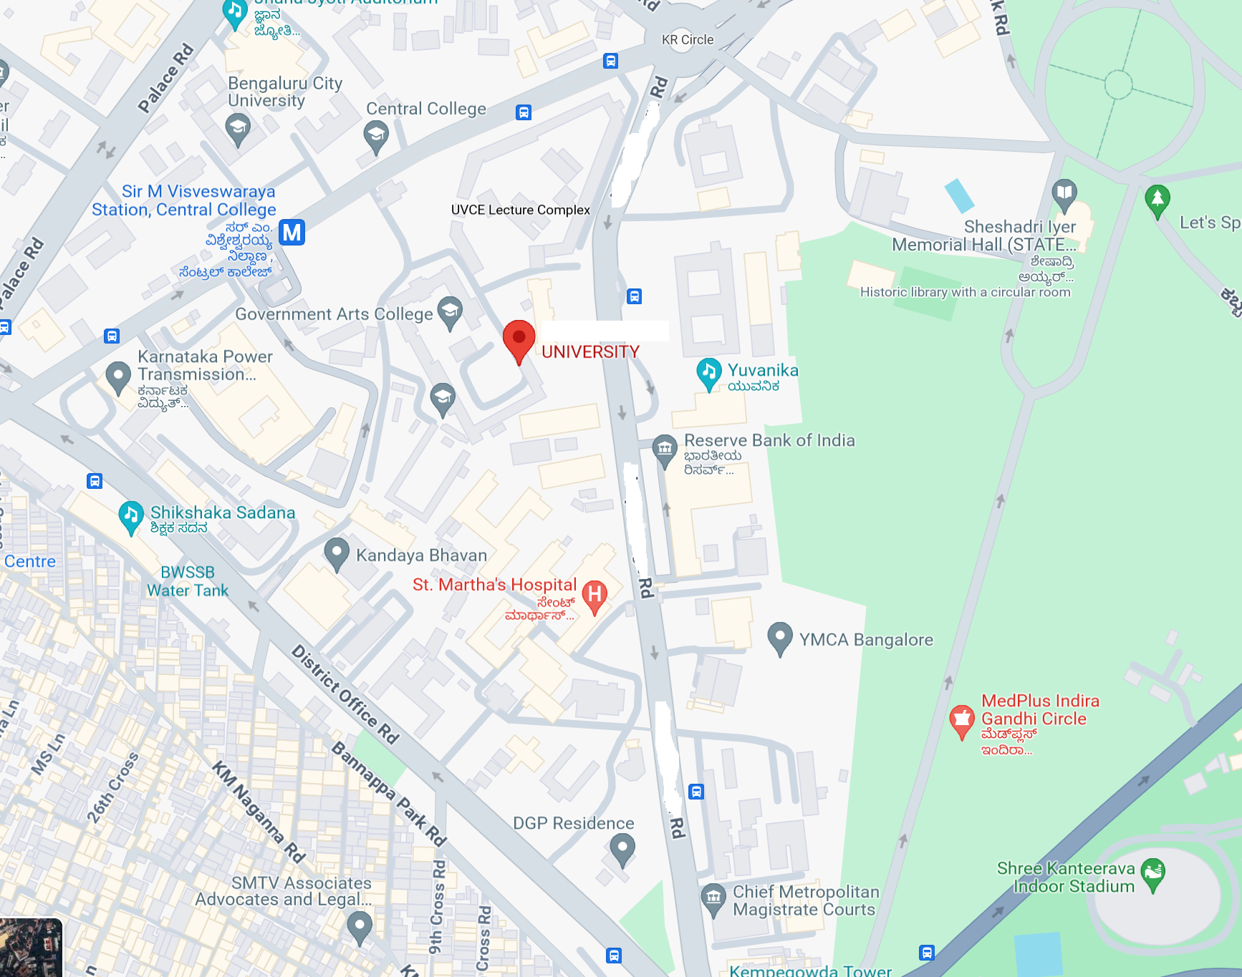

Slide 41
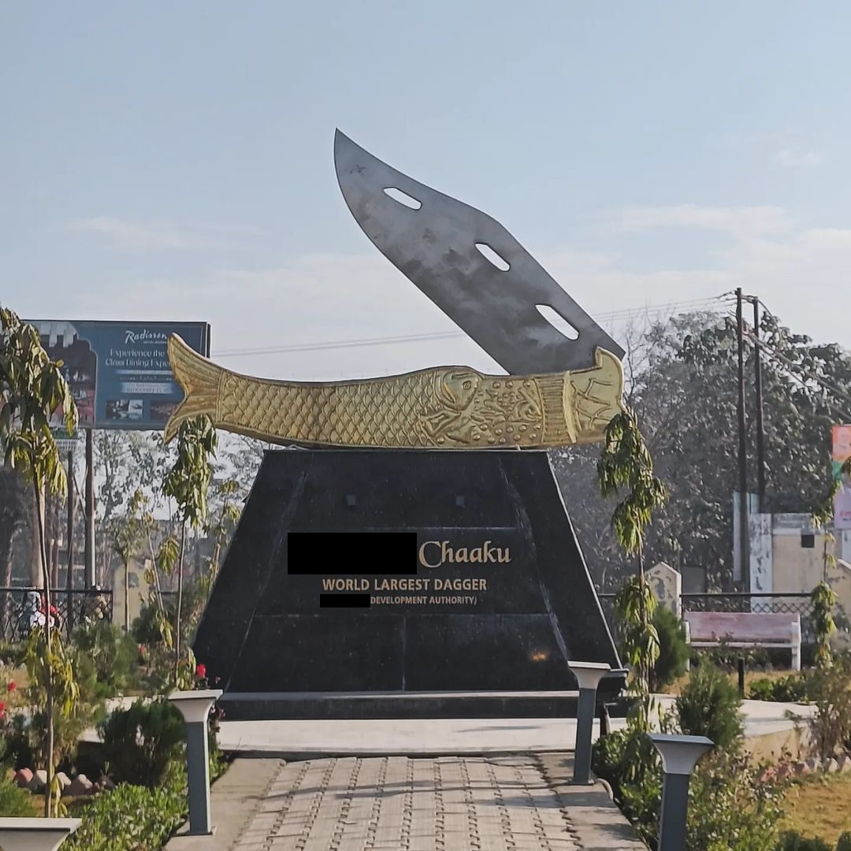
29.
From the 60s to the early 80s this item was the weapon of choice among thugs & Bollywood villains; its popularity dipped considerably in the 90s following restrictions on its manufacture.
What item? Or where in UP will you find this monument?

Slide 42
30.
Childbirth once used to be a social event exclusively attended by women, who would engage in a certain activity while waiting. The term for such women comes from the Old English words for the almighty, and the term for the godparents of one’s child. By the 16th century, the word assumed the meaning of a person, mostly a woman, who engaged in that activity. By the 19th century, the term was extended from the person to the activity itself.
What’s the 7-letter word? If it helps, said activity isn’t restricted to women.

Slide 43
31
In which town is the source of this green laser beam located?
What does it represent?

Slide 44
32.
What is the blanked-out pun in this Amul Topical?

Slide 45
33.
The ______ well is situated in the Masjid Al-Haram in Mecca. Some Muslims believe that it has magical and healing properties. ______ is also the name of a major cola brand in Iran, as well as the name of many small tea stalls in the Indian subcontinent (including Bangalore). Fill in the blanks.

Slide 46
34.
Patrick Blackett was a British physicist who won the Physics Nobel Prize in 1948, “for his development of the Wilson cloud chamber method, and his discoveries therewith in the fields of nuclear physics and cosmic radiation”.
However, he finds fame in pop culture because one of his frustrated young students tried to murder him with poison. Name the student, who went on to gain both fame and infamy later on in life.

Slide 47
35.
Pictured here is a conference room inside the international global headquarters of which corporation?
The building was designed by IM Pei and is located rather appropriately on Purchase Street in Purchase, New York.

Slide 48
Section Three
Rules
25 questions x 2 points

Slide 49
36.
While in college Charles Darwin was a member of the X club, a group of students devoted to "birds and beasts which were before unknown to the human Y” Once he embarked on The Beagle, Darwin's penchant for bold choices continued to evolve bringing him into close contact with animals including pumas, iguanas, armadillos, 20-pound rodents, giant tortoises and their bladder contents.
What is X? What did they do in this club?

Slide 50
37.
In the 8th century an obscure Buddhist king in Afghanistan defeated the mighty Abbasid empire and forced them to pay tribute.
This king’s Chinese allies called him “Fromo Kesro” – implying he was ambitiously (or fan-boyishly) named by his father, in honour of another distant figure.
Fromo Kesro's victories may have forged parts of the legend of the Tibetan King whose name appears to be phonetically similar: Phrom Ge-sar.
Tell me what or who this king is named after. Why was he named so?

Slide 51
38.
On the left is a chained creature, that features in the Japanese video game Sekiro. On the right is a historic Chinese depiction of the same creature - which Confucians once argued did not possess a soul.
Rather rudely this creature was conflated with a certain new arrival to the region - so any ideas about this sort of monster was inspired by encounters with the newly arrived curiosities.
What are these creatures? What are they inspired by or based off?

Slide 52
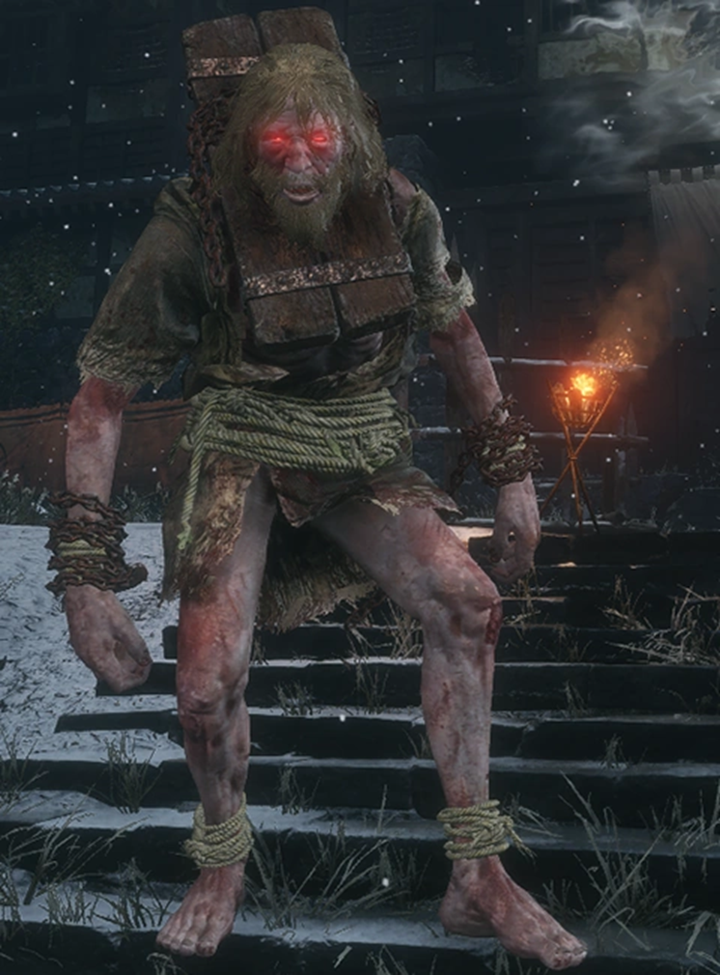
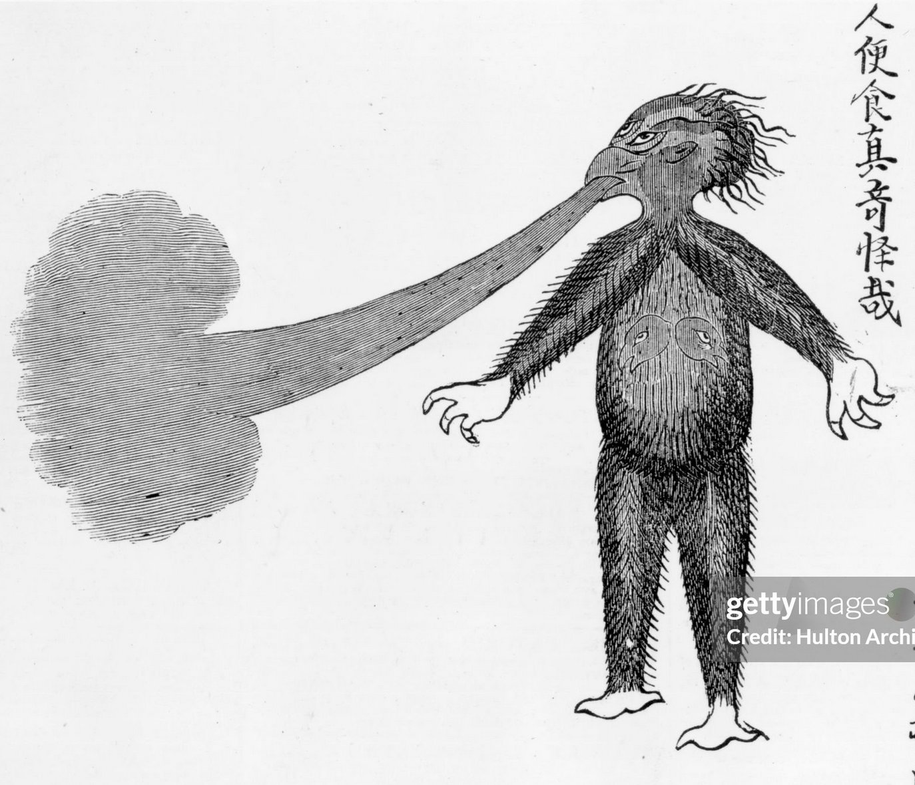
06.

Slide 53
39.
Some ATM’s in X city are unique. Give X and what makes them unique.
Image follows

Slide 54
39.

Slide 55
40.
The following image is a statue made in Kerala, pre- European contact, in a style that became rare shortly after. Who is depicted here? Why did this style go out of favour?

Slide 56
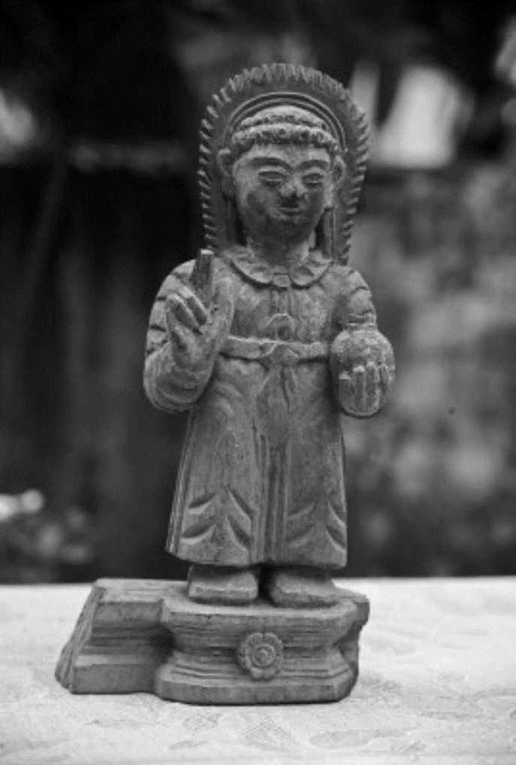
40.

Slide 57
41.
Who is fashion icon and social media star Uorfi Javed trolling and the supposed cause the other star campaigned for?

Slide 59
42.
Originally the song X was not part of the film. They had already shot with Y, an iconic song from a movie that will again have a reboot. The music director had said in an interview “A song from another movie doesn’t qualify for anything, and it doesn’t seem right.” Hence X was composed and time stretched to the extra beats per minute.
Name X that has brought so many laurels even though fans believe the musician had composed much better songs. Name Y a Hindi chartbuster from the 2000s.

Slide 60
43.
In 2014, artist Laxman Aelay was asked to design the emblem of a state. He incorporated structures associated with the two dynasties in the region.
A decade later, a new government has decided to change the state’s logo as they believe it symbolises aristocracy and dictatorship of rulers in the past. Although historians say they represent city planning.
Name the state and the two dynasties.

Slide 61
44.
When beer brand Peroni posted its sponsorship announcement with Ferrari, fans believed that it was a clue for the arrival of X.
However, Peroni added this minor detail as a tribute to Y, who on a historic victory had this detail on his car.
Name X and Y.

Slide 63
45.
X’s squeaking voice, bulging round eyes, and enormous ears help him fit in with other creatures which makes him a beloved character in the world of Z.
Although there was a rumor since the early 2000s, with some news outlets suggesting that Y, an unpopular figure in the West himself accused the franchise of adapting his likeness into X's design and wanted to sue the producers for the ‘supposed similarities’.
ID the character X and the leader Y.

Slide 64
46.
This Kannada movie franchise has 2 parts, and its title is a 3-letter abbreviation that is the name of a defunct mining town in Karnataka. It was created by Prashanth Neel and stars Yash in the lead role. Give the abbreviation.
This song by Sting was released in 1993 as part of his fourth album titled Ten Summoner’s Tales. Its 3-word title is a slight paraphrasing of the last two letters of the movie franchise’s name (i.e., if the movie franchise is XYZ, then the 3-word name of the song is “Z of Y”). Name the song.

Slide 65
47.
The lost second part of a classical work X inspired a plot element in a 1980 best-seller Y. This is the writer Z talking about his book Y.
In truth, what really happened with my desire to write a book on comedy was that I wrote __ ____ __ ___ ____ instead. It was one of those cases in which, when you are unable to construct a theory, you narrate a story. And I believe that in __ ____ __ ___ ____, I did, in narrative form, flesh out a certain theory of the comic. The comic as a critical way of undercutting fanaticism. A diabolical shade of suspicion behind every proclamation of truth.”
Name any two of XYZ.

Slide 66
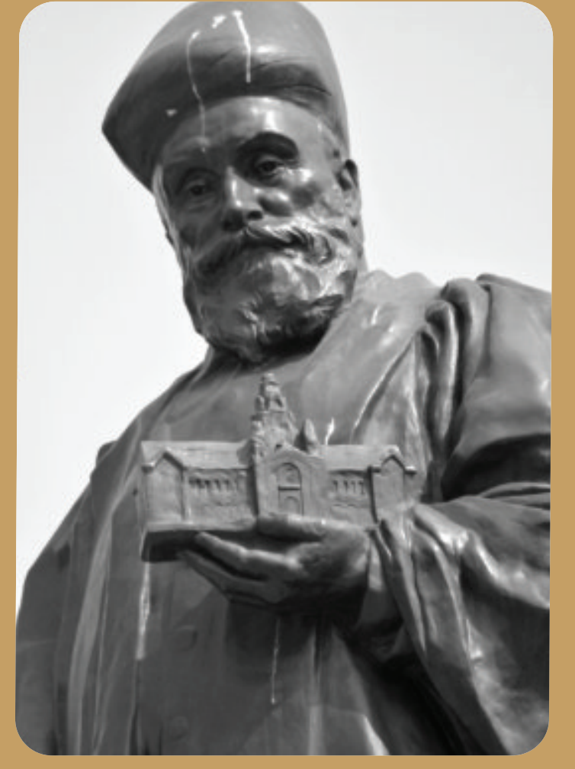
48.
A
WHO is this?
B
WHAT is he holding or where would you find this statue?
B is often known by A’s name.

Slide 67
49.
The genesis of the current border dispute between countries X and Y goes back to their colonial masters Spain, on the one hand, and UK/Holland on the other.
The Royal Geographical Society hired the explorer Robert Schomburgk to explore as far as the mouth of the Orinoco river in 1835. This was used to grab territory for the UK.
Which are the two countries X and Y which are now at loggerheads?

Slide 68
50.
In 1957, X visited Florence, Oregon, where the U.S. Department of Agriculture was attempting to stabilize a natural occurrence and therefore prevent them from damaging roads and buildings—by planting European beachgrass and other fast-growing foliage.
X planned to write a feature on this, titled “They Stopped the Moving Sands.” The piece was never finalized, but it prompted him to go into a research rabbithole, and a fascination for the ideas of ecologist Paul Sears took its place.
Who was X? What was the final result Y of this fascination?

Slide 69
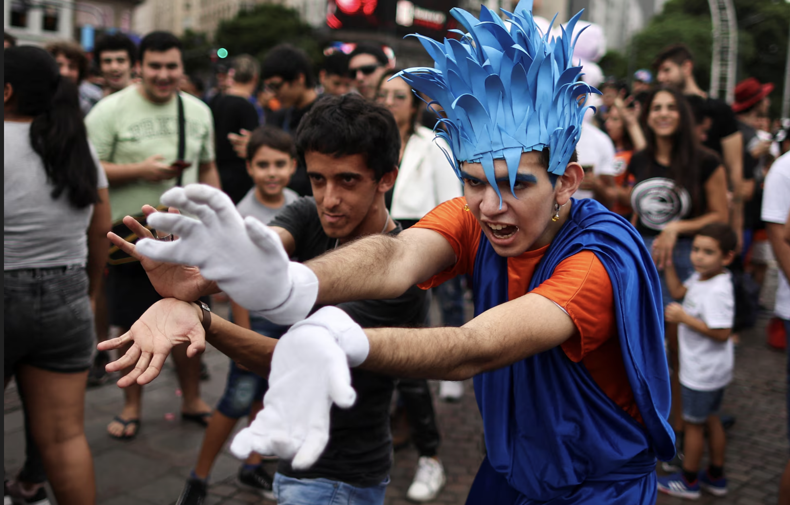
51.
These are Argentinian fans of Akira Toraiyama paying tribute to him and his creation X on hearing of his passing.
He was a big fan of the 1973 film Y and put in a reference to Y in the name of X.
Name X and Y

Slide 70
52.
Top right is the Japanese delicacy Shiraku. Bottom right we have another delicacy known as Kujira. Shiraku is eaten raw or as tempura, and is described as buttery with an aftertaste of sea. Kujira is chewy but salty and causes much controversy. What are Shiraku and Kujira?

Slide 71
53.
Who is this poster paying tribute to?
The poster also pays tribute to a 2003 film set in East Germany at the time of the fall of the Berlin Wall–replacing one name Y with Putin.
Answer as X and Y.

Slide 72
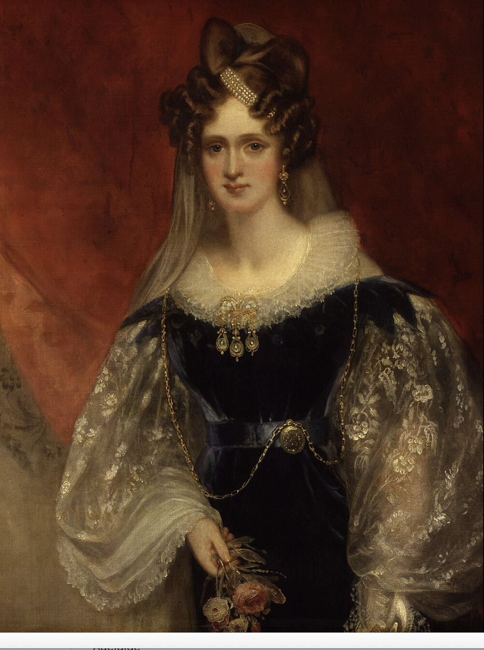
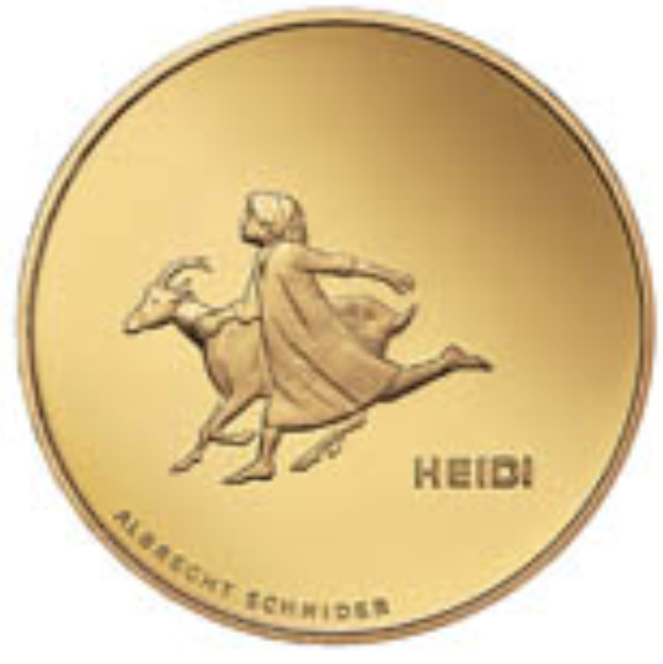
54.
This is a German princess who was married to William IV, predecessor to Queen Victoria. Her anglicised name lives on in a city X on what was then a newly discovered continent.
This German name Adalheide was often also shortened, and that is where we get the title of a

Slide 73
55.
If you spell it as one word of nine letters it denotes a barren stretch.
If you turn it into a two-word phrase of 5 and 4 letters, it probably refers to a literary work from 1922.
Give us either spelling.

Slide 74
56.
X & Y are a fictional pair, often compared to Sherlock Holmes and Dr Watson, but perhaps the roles are slightly reversed, or at least subverted. The two live in London, in a flat in Berkeley Mansions, and occasional clashes that sometimes occur "when two men of iron will live in close association", are the exception. X describes Y as “having a feudal spirit”, while Y thinks X is “ mentally somewhat negligible, but he has a heart of gold”. X often gets into trouble, usually caused by an aunt or a relative, or a girl X fancies, and has to be rescued by Y.
Identify X & Y

Slide 75
57.
This feature and a sort of landmark in Bangalore was declared a National Geological Monument in 1945, and termed typical of the Peninsular Gneiss — a kind of granite rock formation unique to peninsular India. The term Peninsular Gneiss was first coined by W F Smeeth who studied this feature, while working at Mysore Geological Department in 1916. Another monument on top of this geological monument was supposed to mark the boundary of Bangalore.
What are we talking about here?

Slide 76
58.
Designer Eileen Grey created this chair in the 1920s, designed to resemble “Bib”, a very iconic mascot. Plush and comfortable, the chair and its inspiration became household names in Europe. Bib was “born” in 1894, when company founder looked at some objects in the Lyon Universal fair and said “Look, with arms it would make a man!” Who is Bib, and how do we better know him as?
While Bib is plump and fluffy, another organisation, headquartered in Chennai, in the same industry went with a more trim, muscular look for their own mascot, to cue ideas of strength and endurance.
Both organisations’ names also begin with the letter M.
Name them.

Slide 78
59.
X was first held in 1927, and organised to coincide with the Madras session of the Indian National Congress. The following year, a group of artists came together and formed the Y, which began organising X every year since.
This year, X has been in the news recently, over Y’s decision to award a certain individual its high prize.
Identify X & Y.

Slide 79
60.
‘ ______ manade’ was the alliterative slogan and demand of Potti Sriramulu, in 1952. Sriramulu was on a hunger strike, aimed at forcing the new Government of India to declare two things, but eventually only one came to fruition. Potti Sriramulu eventually died while still protesting ‘______ manade’. FITB and identify his two demands.
The _____ ___ committee of 1953 was constituted and they eventually submitted a report in 1955, following which government enacted laws and made changes to the Constitution. Name the committee, or explain what the recommendations were.

Slide 80
61.
One of the nominees for Best Documentary Film at this year’s Academy Awards told the story a rape survivor & her family’s long fight for justice. However the filmmakers seem to have violated Indian law - the survivor was filmed when she was a minor, and her name, face & other identifying details are revealed in the film.
What act of bravery does the film’s title refer to? What 2012 law does the film violate?

Slide 81
62.
Corundum is a crystalline form of Al₂O₃, and contains traces of metals like Fe, Va, Cr and Ti, which are responsible for its brilliant colours.
The gem variety is generally referred to as ________, except when it is red, when it is then called ____.
Fill in the blanks.

Slide 82
63.
In the 1930s, this Indian scientist built a ‘photographic profiloscope’ to accurately measure individual people’s facial features. He used these measurements to calculate what he called a D² statistic, a relative value of distance between any two groups. (pictures on next slide)
Who was this scientist? What was he trying to establish?

Slide 83
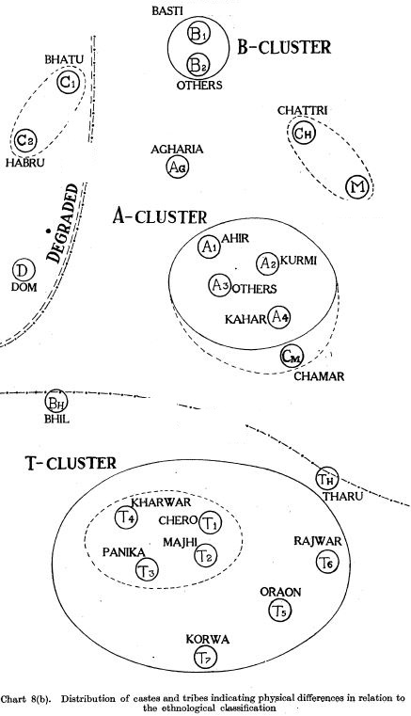
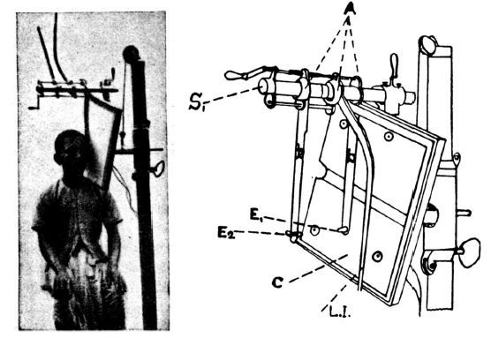

Slide 84
64.
“The Great ___________ Question” was a 19th century dispute on human and ape origins, centered around a part of the brain’s limbic system named for its resemblance to a seahorse. Richard Owen argued that only humans had it, while T. H. Huxley argued it was common to apes & humans, and that we were not unique.
The controversy & rivalry were satirised as the “great hippopotamus test” in this 1863 work of Christian redemption, once a mainstay of children's literature.
What brain structure? And what literary work?

Slide 85
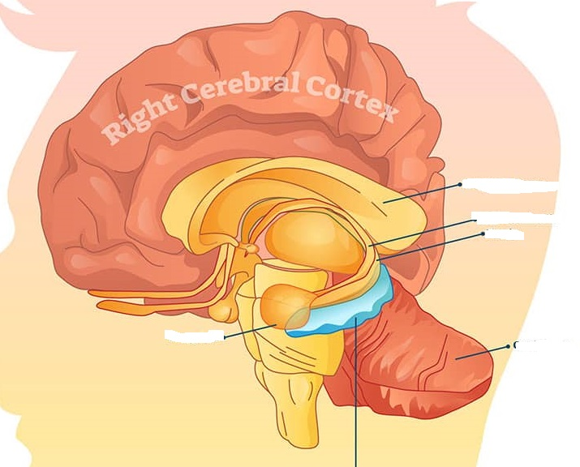
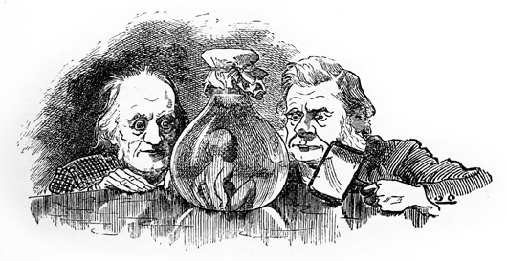

Slide 86
65.
“This is a _____ ____” is often quoted out of context and was a line used to denigrate X. Here is his full statement (almost):
"When one stands here, and sees the ____ going to the peak of this mountain... I think you would have to conclude that this is a _____ ____ and that it had to be built by a [adjective] people."
Who talking about what?

Slide 87
FINIS

Slide 88
Section One
Rules
15 questions x 1 point
Stake +1 or +2 for equal negatives

Slide 89
01.
The Vummidi Bangaru Jewellers was in limelight due to a certain ‘symbol’ they were connected to seven decades ago which made a re-entry last year. Consisting of three parts, topped by a Nandi, the middle portion is engraved with motifs of Goddess Lakshmi. The last portion, an elongated stem, is engraved with the images of Kodimaram, a sacred tree indicating fertility.
ID the object which shot to prominence despite people debating the use of this symbol.

Slide 90
Sengol

Slide 91
02.
The name of this TV channel is not nonsensical as commonly assumed but was named after a type of theater that existed in the US in the 1900’s. These theaters got their name after the admission fee they charged.
What TV Channel?

Slide 92
Nickelodeon

Slide 93
03.
X was invented after an animal feed manufacturer in Wisconsin changed their machine cleaning technique. Whenever their corn grinder clogged, they poured moist ground up corn to unclog the machine.
When the machine got too hot the moist corn would puff up and form tube like curls. What was invented here?

Slide 94
Cheetos

Slide 95
04.
They were originally known as the Whoop-Ass girls and their designs were inspired by painter Marget Keanes. Who are they?

Slide 96
04.

Slide 97
The powerpuff girls

Slide 98
05.
The rules for naming were devised by X’s founder, who had dyslexia and had trouble remembering the order of numbers in item codes.
A designer explained that X has a crack team to come up with product names, who assign names from a database of words. Bookcases are named after professional occupations or boys’ names. Rugs are named after cities and towns around the region where X is based at, while bed sheets, comforters and pillowcases are named after flowers and plants.
Identify X.

Slide 99
IKEA

Slide 100
06.
Kirsty Paterson, who has been branded the "sad X" on social media has been shocked by the reaction. “When we took the job we had no idea what we were walking into.” Kirsty said to the BBC that she was able to see the funny side of it now but felt she had to speak out to show the person behind the green wig.
What infamous event designed by images from AI had brought worldwide fame to an experience inspired by a fictional character?

Slide 101
The Willy Wonka Experience

Slide 102
07. One point
Of his name, he says his father originally wanted him to be called Ayyadurai, in honour of the two leaders of the Dravidian Self Respect Movement. But at a public meeting in 1953, to condole the death of another world leader, his father declared the name we all now know him by. Identify?

Slide 103
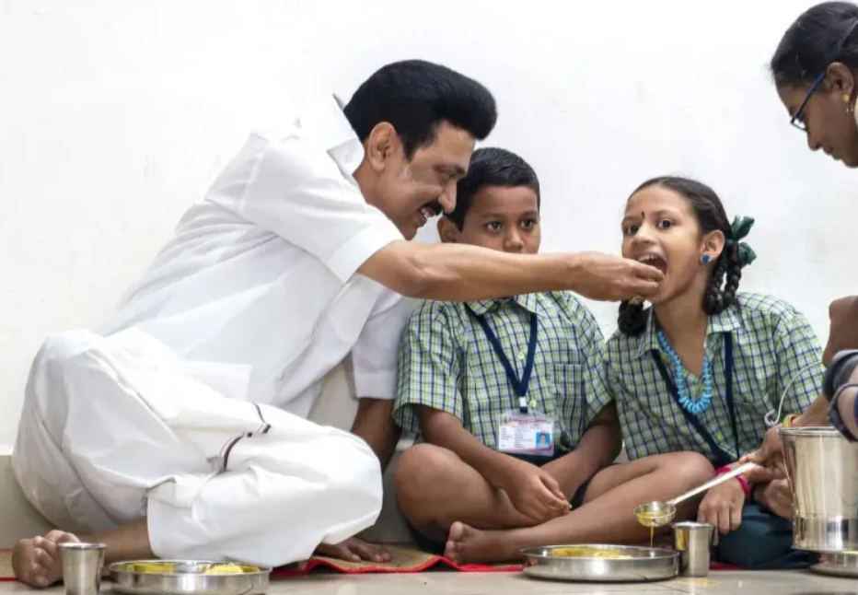
Ans
M.K Stalin, who was to be named Ayyadurai after “Ayya” Periyar, and Annadurai.
But M. Karunanidhi was attending a condolence meeting for Joseph Stalin and at this meeting declared his new born son will be called Stalin in honour of the man who resisted Nazis.

Slide 104
08.
In 2009, self-described “guerilla ethnomusicologist” Christopher Kirkley was touring the Sahel and western Africa. Despite the lack of recording studios, he found that the ‘desert blues’ music of people like Abdallah Oumbadougou, Mdou Moctar, El Wali etc., was widely being listened to and shared by people, thanks to a device that was then being widely adopted.
What devices?

Slide 106
Cellphones

Slide 107
09.
Three modern novels based on which epic?

Slide 108
The Mahabharata

Slide 109
10.
MS Golwalkar, the 2nd chief of the RSS disapproved of the Indian flag saying that “the tricolour would be inauspicious for the Nation, as Hindu religion considers the number 3 to be inauspicious”.
In response, this titan of the freedom struggle remarked “What to say about a person who does not understand that there are only 3 main gods in Hindu religion - Brahma, Vishnu & Shiva?”
Who was this person?

Slide 110
Sardar Vallabhbhai Patel

Slide 111
11.
Packaged drinking water brand commemorating (!!) a momentous act of civil resistance led by a future law minister of India that occurred 97 years ago in Raigad district, Maharashtra.
What incident?

Slide 112
Mahad Satyagraha or the Chavdar Tale Satyagraha

Slide 113
12.
One theory says that this happens as these animals use moonlight to navigate & therefore get confused, another that it is because they move in a particular direction to escape danger.
We now have a more compelling answer: these animals evolved to tilt their back to wherever is brightest; for hundreds of millions of years, this was the night sky, and this behaviour told them which way was up. Humans have changed the environment increasingly, leading to catastrophic results.
What behaviour, one that refers to an irresistible & dangerous attraction?

Slide 114
Moths/insects being drawn to a flame

Slide 115
13.
You will often seen bottles of pink solution in photos of Anti-Corruption Bureau sting operations. ACB officials provide the complainant with currency notes smeared with a colourless powder. When the money has changed hands, ACB officials swoop in and get the corrupt official to dip their fingers in bottles filled with basic sodium carbonate solution. If it turns pink, it proves that the official took the bribe.
What substance, familiar to all school chemistry students, is used to catch one pink-handed?

Slide 116
Phenolphthalein (a widely used acid-base indicator)

Slide 117
14.
Sergei Krikalev (in photo) and Alexandr Volkvo have been dubbed the “last citizens of the Soviet Union.”
What did they do, or what happened for them to be described thus?

Slide 118
Krikalev and Volkov were aboard the Mir space station when the USSR fell apart.
It took a while for equally experienced replacements to be sent up, and for them to be flown down to Earth

Slide 119
15.
Connect (one word) the pictures to a Google product that was previously called “Bard”.

Slide 120
Gemini

Slide 121
Section Two
Rules
20 questions x 1 points

Slide 122
16.
You could call it a form of social distancing since one of its benefits is disease control.
What two word term suggesting top level introversion is used for such adaptive behaviour?

Slide 123
ANSWER
CROWN SHYNESS OR CANOPY SHYNESS

Slide 124
17.
Shakespeare Sarani is a major road in Kolkata. It is also one of the very few places in India that got renamed after a British person post-independence (in 1964). The British era name of this road was _______ Road. Fill in the blanks with a common English word that Shakespeare was known for. The old nomenclature was due to the presence of the _______ of Calcutta, a structure that was burned down in a fire in 1839 and never rebuilt.

Slide 125
Theatre

Slide 126
18.
The ICAR Canned Beef Monument has returned to public attention due to the West’s response to Israel’s genocide of Palestinians.
The monument’s creators say their sculpture wasn’t a tribute, as the aid received then was of the wrong kind: barely-edible canned food, including expired food from the Vietnam war, and pork for the half-Muslim country.
In which city will you find this monument?

Slide 127
Sarajevo

Slide 128
19.
Zipper and hair are misaligned
Edges of tiles appear repeated
Hair has artificial pattern
Portion of sleeve is missing
The one in bold was spotted first and eventually led to a range of conspiracies and memes. What are we discussing here?

Slide 130
20.
One of the most famous lines in all of literature contains a tricky-to-translate phrase that’s essential to the plot: ungeheuren Ungeziefer. It has no direct translation outside the language.
The word Ungeziefer translates to something like “an unclean animal unfit for sacrifice,” but the phrase is also used by native speakers to describe any kind of repulsive vermin.
Which work is talked about here?

Slide 131
Kafka’s Metamorphosis

Slide 132
21.
For her role in the Devil wears Prada, Meryl Streep took inspiration from an unlikely figure. As she explained “He never, ever, ever raises his voice and everyone has to lean in to listen, and he is automatically the most powerful person in the room”
Who was she inspired by?
Hint – he later became a mayor of a small town

Slide 133
Dirty Harry

Slide 134
22.
President Biden recently gave the State of the Union address where he underlined his commitment towards reproductive rights among many other issues. Among the invitees were an Elizabeth Carr as a guest of Senator Tim Kaine of Virginia.
How did Carr become part of medical history in the US?

Slide 135
First IVF baby in the US

Slide 136
23.
This newly built house in Kolenchery is designed as a cantilevered structure composed of two volumes that branch out from a central core. The habitable spaces of the residence is above the benchmarked level of 3.2 meters.
What is the reason for setting it above 3.2m?

Slide 137
23.

Slide 138
During the Kerala floods in 2018, the water level on the site rose to 3.2 meters
The house is located on the banks of the Muvattupuzha in Kolenchery, Ernakulam district

Slide 139
24.
In the picture is college student Zoe and her father Dave. A photo Dave took of Zoe in 2005 spread like wildfire across the world and has helped Zoe earn close to half a million dollars recently. How do we know Zoe better?

Slide 140
Ans
The ‘Disaster Girl’.
Zoe Roth is the girl in the picture. She auctioned an NFT of this image in 2019 for about 180 Ether coins (a crypto currency) which is currently valued at about USD 495,000.

Slide 141
25.
Everybody thinks it is this.
But it is actually this.
What are we talking about here?

Slide 144
Ans
The Tamil Nadu state emblem. The belief, almost universally, is that the gopuram (temple entrance tower) depicted in the emblem is based on or a depiction of the Sriviliputur Vadapatrasayee temple gopuram (also known as Sriviliputur Rajagopuram or Andal temple gopuram).
However, the artist who designed the emblem has said he based it on the West Gopuram of Madurai’s Meenakshi Sundareswarar temple.

Slide 145
26.
What clothing/accessory choices of Dr Who and Good Omens star David Tennant has had people like Graham Linehan, Helen Joyce, Kelly J Keen, amongst other followers of JK Rowling’s twitter account, throw a hissy fit?

Slide 148
Ans
David Tennant has been wearing T Shirts with messages in support of transgender individuals. He also has been pictured with Rainbow/Trans Pride flag pins, and in particular a Tardis with the colours of Trans pride.
This has upset transphobic, gender critical persons such as Graham Linehan, amongst others.

Slide 149
27.
Jan 24, 2000 | Jan 13, 1884
Feb 17, 2005 | Feb 06, 1884
Mar 29, 1996 | Mar 01, 1908
The first part of each of these date-pairs break one of the longest-held beliefs about Bengaluru, but the second part perhaps supports it. What respite can you and I, and everyone in this room get, if we know what these date-pairs signify?

Slide 150
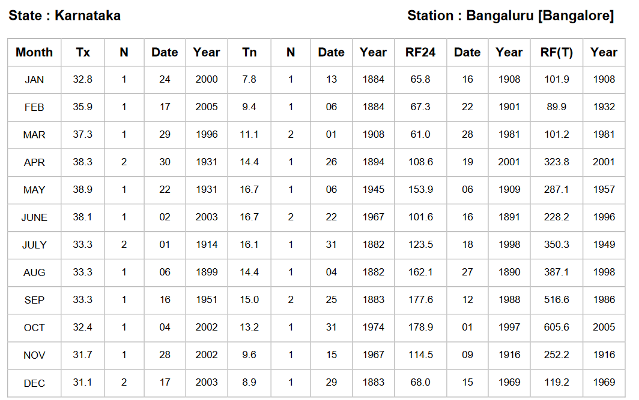
Ans
These dates are the extremes — highest or lowest — temperatures recorded for respective months, in Bengaluru city, since records began.
Temperature on March 5, 2024 hit 36 degrees, the hottest day of the year this far. The highest ever temperature recorded in the city was in May 1931, when the mercury hit 38.9 degrees C.

Slide 151
28.
In 2020, its centenary year, the Government Science College was upgraded to an university. It was named after a 9th century emperor of the Rashtrakuta dynasty, an accomplished poet & scholar who wrote the Kavirajamarga, the earliest extant literary work in Kannada.
Just name this notable monarch of ancient India.

Slide 152
You can use this slide if you want to give a clue.
Else delete it.

Slide 153
Amoghavarsha I (aka Amoghavarsha Nrupathunga)

Slide 154
29.
From the 60s to the early 80s this item was the weapon of choice among thugs & Bollywood villains; its popularity dipped considerably in the 90s following restrictions on its manufacture.
What item? Or where in UP will you find this monument?

Slide 155
Rampur district - Rampuri Chaaku

Slide 156
30.
Childbirth once used to be a social event exclusively attended by women, who would engage in a certain activity while waiting. The term for such women comes from the Old English words for the almighty, and the term for the godparents of one’s child. By the 16th century, the word assumed the meaning of a person, mostly a woman, who engaged in that activity. By the 19th century, the term was extended from the person to the activity itself.
What’s the 7-letter word? If it helps, said activity isn’t restricted to women.

Slide 157
Gossip

Slide 158
31
In which town is the source of this green laser beam located?
What does it represent?

Slide 159
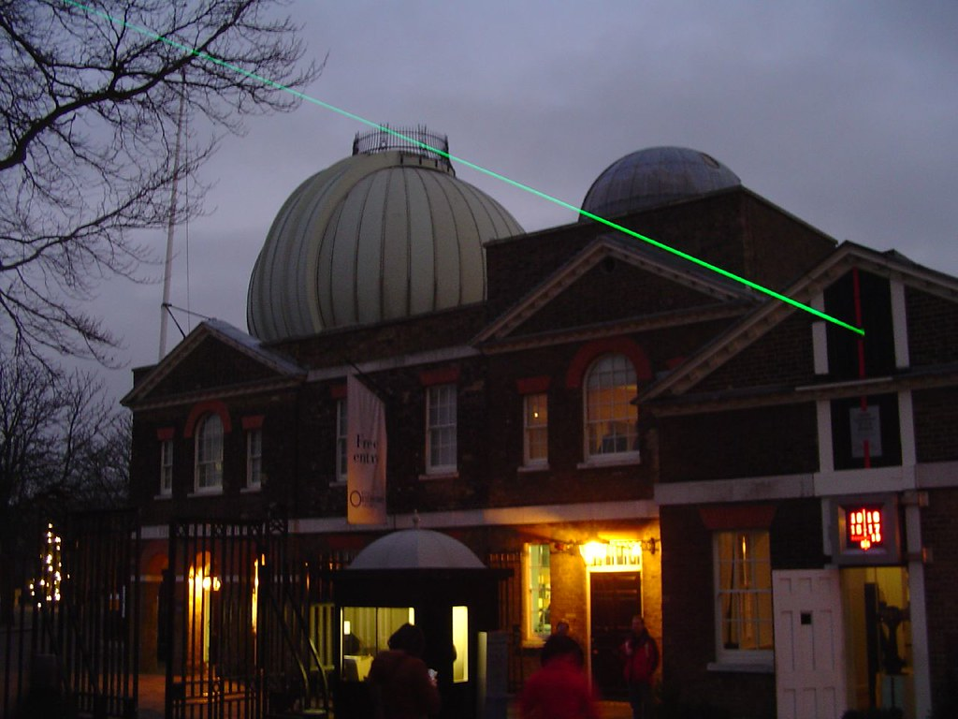
Greenwich (Royal Observatory)
0° longitude/ Prime meridian/ Greenwich meridian

Slide 160
32.
What is the blanked-out pun in this Amul Topical?

Slide 161
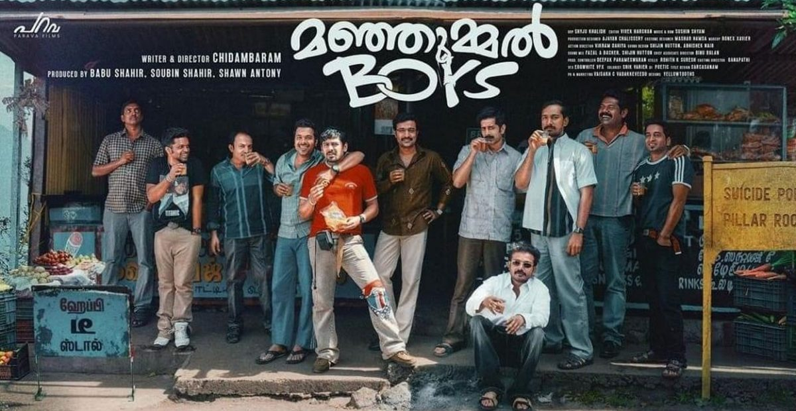
Manjamul Boys

Slide 162
33.
The ______ well is situated in the Masjid Al-Haram in Mecca. Some Muslims believe that it has magical and healing properties. ______ is also the name of a major cola brand in Iran, as well as the name of many small tea stalls in the Indian subcontinent (including Bangalore). Fill in the blanks.

Slide 163
Zamzam

Slide 164
34.
Patrick Blackett was a British physicist who won the Physics Nobel Prize in 1948, “for his development of the Wilson cloud chamber method, and his discoveries therewith in the fields of nuclear physics and cosmic radiation”.
However, he finds fame in pop culture because one of his frustrated young students tried to murder him with poison. Name the student, who went on to gain both fame and infamy later on in life.

Slide 165
Robert Oppenheimer

Slide 166
35.
Pictured here is a conference room inside the international global headquarters of which corporation?
The building was designed by IM Pei and is located rather appropriately on Purchase Street in Purchase, New York.

Slide 167
Mastercard

Slide 168
Section Three
Rules
25 questions x 2 points

Slide 169
36.
While in college Charles Darwin was a member of the X club, a group of students devoted to "birds and beasts which were before unknown to the human Y” Once he embarked on The Beagle, Darwin's penchant for bold choices continued to evolve bringing him into close contact with animals including pumas, iguanas, armadillos, 20-pound rodents, giant tortoises and their bladder contents.
What is X? What did they do in this club?

Slide 170
X – Glutton/ Glutton club
Eat newly discovered animals

Slide 171
37.
In the 8th century an obscure Buddhist king in Afghanistan defeated the mighty Abbasid empire and forced them to pay tribute.
This king’s Chinese allies called him “Fromo Kesro” – implying he was ambitiously (or fan-boyishly) named by his father, in honour of another distant figure.
Fromo Kesro's victories may have forged parts of the legend of the Tibetan King whose name appears to be phonetically similar: Phrom Ge-sar.
Tell me what or who this king is named after. Why was he named so?

Slide 172
Rome Caesar or Roman Kaîsar
He was thus named because the Romans were also fighting the Arabs

Slide 173
38.
On the left is a chained creature, that features in the Japanese video game Sekiro. On the right is a historic Chinese depiction of the same creature - which Confucians once argued did not possess a soul.
Rather rudely this creature was conflated with a certain new arrival to the region - so any ideas about this sort of monster was inspired by encounters with the newly arrived curiosities.
What are these creatures? What are they inspired by or based off?

Slide 174
06.

Slide 175
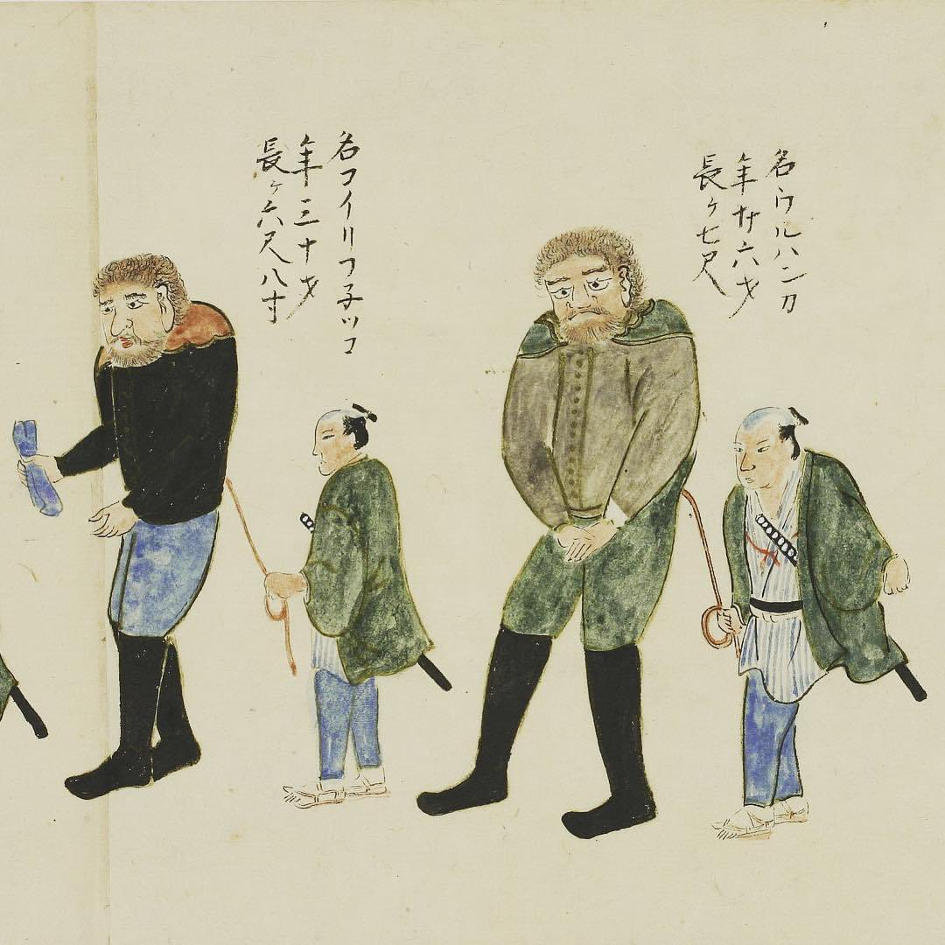
Giants/ Ogres
Europeans (Dutch/ Portuguese)

Slide 176
39.
Some ATM’s in X city are unique. Give X and what makes them unique.
Image follows

Slide 177
39.

Slide 178
Vatican city,
They are in Latin. No points for Comic Sans.

Slide 179
40.
The following image is a statue made in Kerala, pre- European contact, in a style that became rare shortly after. Who is depicted here? Why did this style go out of favour?

Slide 180
40.

Slide 181
Jesus
It was superseded by more European inspired art styles

Slide 182
41.
Who is fashion icon and social media star Uorfi Javed trolling and the supposed cause the other star campaigned for?

Slide 184
Poonam Pandey and Cervical Cancer

Slide 185
42.
Originally the song X was not part of the film. They had already shot with Y, an iconic song from a movie that will again have a reboot. The music director had said in an interview “A song from another movie doesn’t qualify for anything, and it doesn’t seem right.” Hence X was composed and time stretched to the extra beats per minute.
Name X that has brought so many laurels even though fans believe the musician had composed much better songs. Name Y a Hindi chartbuster from the 2000s.

Slide 186
X- Jai Ho from Slumdog Millionaire Y- Aaj Ki Raat from Don

Slide 187
43.
In 2014, artist Laxman Aelay was asked to design the emblem of a state. He incorporated structures associated with the two dynasties in the region.
A decade later, a new government has decided to change the state’s logo as they believe it symbolises aristocracy and dictatorship of rulers in the past. Although historians say they represent city planning.
Name the state and the two dynasties.

Slide 188
Telangana, Qutb Shahi and Kakatiya

Slide 189
44.
When beer brand Peroni posted its sponsorship announcement with Ferrari, fans believed that it was a clue for the arrival of X.
However, Peroni added this minor detail as a tribute to Y, who on a historic victory had this detail on his car.
Name X and Y.

Slide 191
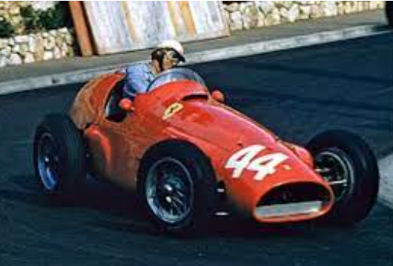
The number 44 X- Lewis Hamilton, Y- Maurice Trintignant

Slide 192
45.
X’s squeaking voice, bulging round eyes, and enormous ears help him fit in with other creatures which makes him a beloved character in the world of Z.
Although there was a rumor since the early 2000s, with some news outlets suggesting that Y, an unpopular figure in the West himself accused the franchise of adapting his likeness into X's design and wanted to sue the producers for the ‘supposed similarities’.
ID the character X and the leader Y.

Slide 193
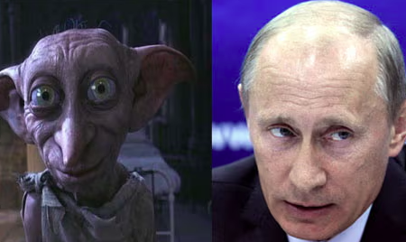
Dobby and Vladmir Putin

Slide 194
46.
This Kannada movie franchise has 2 parts, and its title is a 3-letter abbreviation that is the name of a defunct mining town in Karnataka. It was created by Prashanth Neel and stars Yash in the lead role. Give the abbreviation.
This song by Sting was released in 1993 as part of his fourth album titled Ten Summoner’s Tales. Its 3-word title is a slight paraphrasing of the last two letters of the movie franchise’s name (i.e., if the movie franchise is XYZ, then the 3-word name of the song is “Z of Y”). Name the song.

Slide 195
KGF;
Fields of Gold

Slide 196
47.
The lost second part of a classical work X inspired a plot element in a 1980 best-seller Y. This is the writer Z talking about his book Y.
In truth, what really happened with my desire to write a book on comedy was that I wrote __ ____ __ ___ ____ instead. It was one of those cases in which, when you are unable to construct a theory, you narrate a story. And I believe that in __ ____ __ ___ ____, I did, in narrative form, flesh out a certain theory of the comic. The comic as a critical way of undercutting fanaticism. A diabolical shade of suspicion behind every proclamation of truth.”
Name any two of XYZ.

Slide 197
ANSWER
X; ARISTOTLE’S POETICS
Y: THE NAME OF THE ROSE
Z: UMBERTO ECO

Slide 198
48.
A
WHO is this?
B
WHAT is he holding or where would you find this statue?
B is often known by A’s name.

Slide 199
ANSWER
JN TATA
IISC

Slide 200
49.
The genesis of the current border dispute between countries X and Y goes back to their colonial masters Spain, on the one hand, and UK/Holland on the other.
The Royal Geographical Society hired the explorer Robert Schomburgk to explore as far as the mouth of the Orinoco river in 1835. This was used to grab territory for the UK.
Which are the two countries X and Y which are now at loggerheads?

Slide 201
ANSWER
X; VENEZUELA
Y: GUYANA

Slide 202
50.
In 1957, X visited Florence, Oregon, where the U.S. Department of Agriculture was attempting to stabilize a natural occurrence and therefore prevent them from damaging roads and buildings—by planting European beachgrass and other fast-growing foliage.
X planned to write a feature on this, titled “They Stopped the Moving Sands.” The piece was never finalized, but it prompted him to go into a research rabbithole, and a fascination for the ideas of ecologist Paul Sears took its place.
Who was X? What was the final result Y of this fascination?

Slide 203
ANSWER
X; FRANK HERBERT
Y: DUNE

Slide 204
51.
These are Argentinian fans of Akira Toraiyama paying tribute to him and his creation X on hearing of his passing.
He was a big fan of the 1973 film Y and put in a reference to Y in the name of X.
Name X and Y

Slide 205
ANSWER
X; DRAGON BALL
Y: ENTER THE DRAGON

Slide 206
52.
Top right is the Japanese delicacy Shiraku. Bottom right we have another delicacy known as Kujira. Shiraku is eaten raw or as tempura, and is described as buttery with an aftertaste of sea. Kujira is chewy but salty and causes much controversy. What are Shiraku and Kujira?

Slide 207
ANSWER
X; FISH PROSTATES/SEMEN SACS
Y: WHALE MEAT

Slide 208
53.
Who is this poster paying tribute to?
The poster also pays tribute to a 2003 film set in East Germany at the time of the fall of the Berlin Wall–replacing one name Y with Putin.
Answer as X and Y.

Slide 209
ANSWER
X; ALEXEI NAVALNY
Y: GOODBYE, LENIN

Slide 210
54.
This is a German princess who was married to William IV, predecessor to Queen Victoria. Her anglicised name lives on in a city X on what was then a newly discovered continent.
This German name Adalheide was often also shortened, and that is where we get the title of a

Slide 211
ANSWER
X; ADELAIDE
Y: HEIDI

Slide 212
55.
If you spell it as one word of nine letters it denotes a barren stretch.
If you turn it into a two-word phrase of 5 and 4 letters, it probably refers to a literary work from 1922.
Give us either spelling.

Slide 213
ANSWER
X; WASTELAND
Y: WASTE LAND

Slide 214
56.
X & Y are a fictional pair, often compared to Sherlock Holmes and Dr Watson, but perhaps the roles are slightly reversed, or at least subverted. The two live in London, in a flat in Berkeley Mansions, and occasional clashes that sometimes occur "when two men of iron will live in close association", are the exception. X describes Y as “having a feudal spirit”, while Y thinks X is “ mentally somewhat negligible, but he has a heart of gold”. X often gets into trouble, usually caused by an aunt or a relative, or a girl X fancies, and has to be rescued by Y.
Identify X & Y

Slide 215
Ans
Bertram Wooster and Jeeves

Slide 216
57.
This feature and a sort of landmark in Bangalore was declared a National Geological Monument in 1945, and termed typical of the Peninsular Gneiss — a kind of granite rock formation unique to peninsular India. The term Peninsular Gneiss was first coined by W F Smeeth who studied this feature, while working at Mysore Geological Department in 1916. Another monument on top of this geological monument was supposed to mark the boundary of Bangalore.
What are we talking about here?

Slide 217
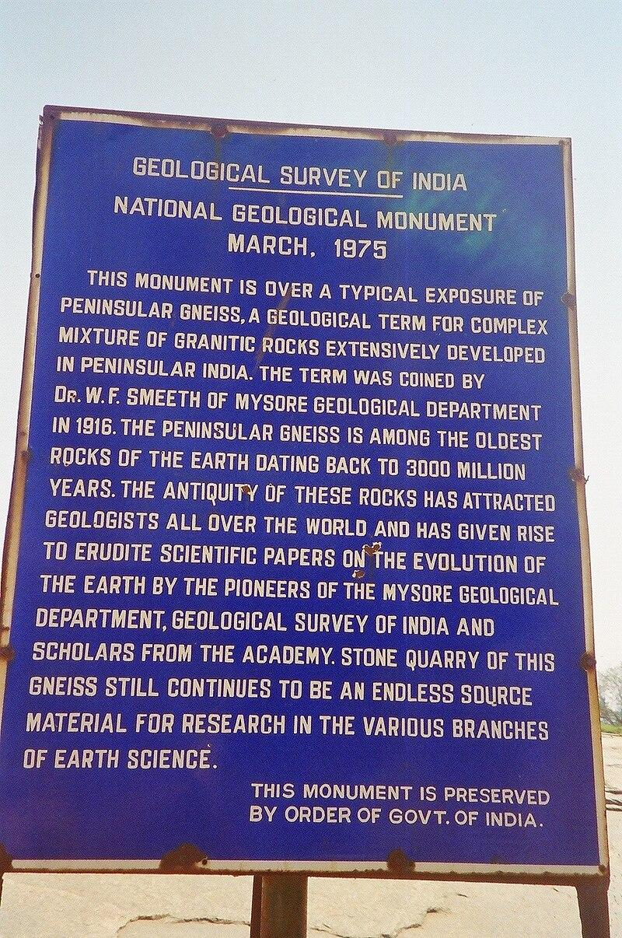
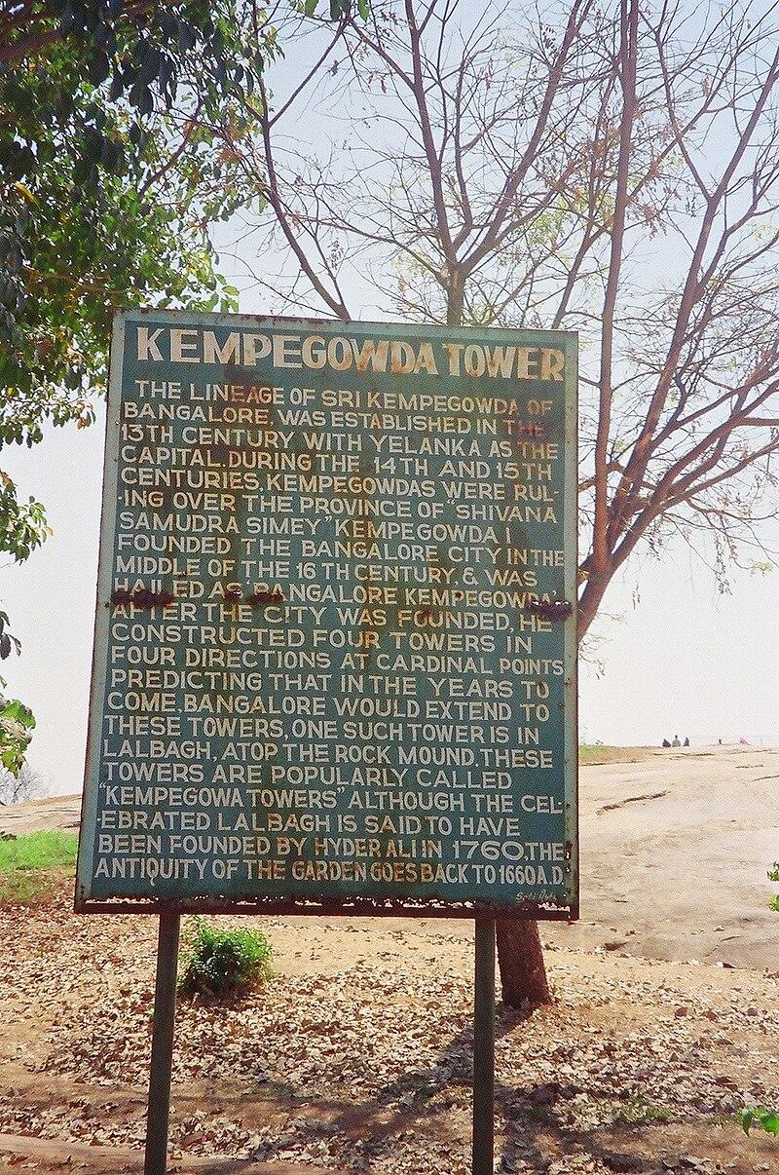
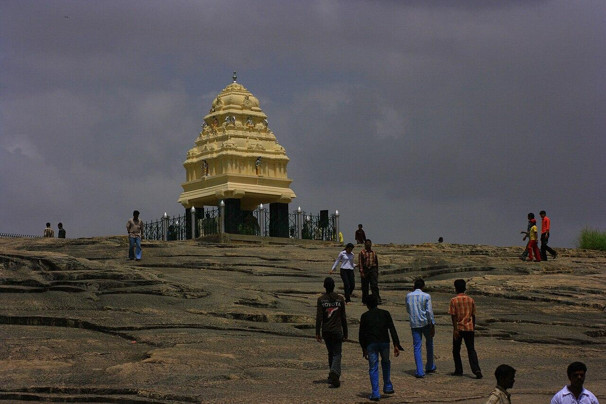
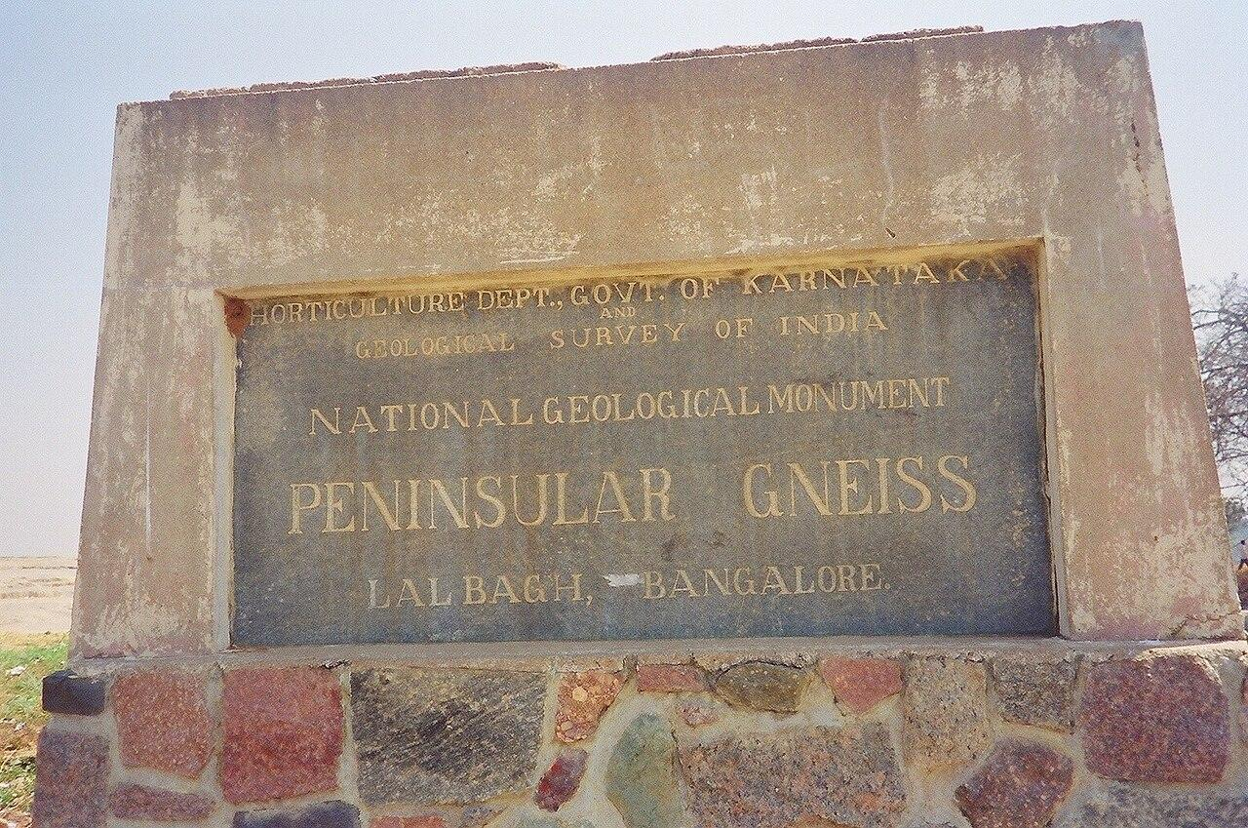
Ans
Lalbagh Hill and Kempegowda tower.
The Lalbagh Hill is considered the typical example of Peninsular Gneiss

Slide 218
58.
Designer Eileen Grey created this chair in the 1920s, designed to resemble “Bib”, a very iconic mascot. Plush and comfortable, the chair and its inspiration became household names in Europe. Bib was “born” in 1894, when company founder looked at some objects in the Lyon Universal fair and said “Look, with arms it would make a man!” Who is Bib, and how do we better know him as?
While Bib is plump and fluffy, another organisation, headquartered in Chennai, in the same industry went with a more trim, muscular look for their own mascot, to cue ideas of strength and endurance.
Both organisations’ names also begin with the letter M.
Name them.

Slide 220
Ans
A: Bib is short for Bibendum, the name of Michelin tyres’ mascot. He is more popularly known as the Michelin Man, and is designed to look like a stack of tyres. Tyres were originally white or dull grey in colour, hence Bibendum’s colouring. In the 1920s, carbon was added to rubber for tyres, to give them strength and durability, and hence the black colouring since.
B. Michelin’s “competition” of sorts is MRF, and their mascot is the MRF Muscle Man, who was first created when MRF went international with an office in Eastern Europe.
The two organisations are Michelin and MRF.

Slide 222
59.
X was first held in 1927, and organised to coincide with the Madras session of the Indian National Congress. The following year, a group of artists came together and formed the Y, which began organising X every year since.
This year, X has been in the news recently, over Y’s decision to award a certain individual its high prize.
Identify X & Y.

Slide 223
Ans
X is the Annual Music Conference
Y is the Madras Music Academy.
The Music conference is in the press recently, as many upper-caste carnatic singers and musicians have decided to boycott the conference over the Music Academy’s decision to award singer T M Krishna a Sangeetha Kalanidhi title. Those boycotting have taken offence to TMK’s attempts to open up carnatic music to a larger society and also of questioning and critiquing the brahmin/upper-caste hegemony in the Carnatic music field.

Slide 224
60.
‘ ______ manade’ was the alliterative slogan and demand of Potti Sriramulu, in 1952. Sriramulu was on a hunger strike, aimed at forcing the new Government of India to declare two things, but eventually only one came to fruition. Potti Sriramulu eventually died while still protesting ‘______ manade’. FITB and identify his two demands.
The _____ ___ committee of 1953 was constituted and they eventually submitted a report in 1955, following which government enacted laws and made changes to the Constitution. Name the committee, or explain what the recommendations were.

Slide 225
Ans
Madras Manade, the slogan of Potti Sriramulu demanding that the city of Madras be included inside the state of Andhra.
Sriramulu demanded the formation of a state, carved out of Madras presidency, for Telugu speakers. He wanted it to be called Andhra State. He also demanded that Madras be made capital of that state.
3. The Fazal Ali Commission, or the States Reorganisation Commission was constituted in 1953. Led by the retired justice Fazal Ali. It recommended that states be divided along linguistic lines, something earlier committees like the Dhar committee had examined but did not recommend. The Fazil Ali recommendations, with some changes and alterations, were accepted and enacted in the Parliament which became the States Reorganisation Act 1956.

Slide 226
61.
One of the nominees for Best Documentary Film at this year’s Academy Awards told the story a rape survivor & her family’s long fight for justice. However the filmmakers seem to have violated Indian law - the survivor was filmed when she was a minor, and her name, face & other identifying details are revealed in the film.
What act of bravery does the film’s title refer to? What 2012 law does the film violate?

Slide 227
To Kill a Tiger
The Protection of Children from Sexual Offences (POCSO) Act 2012

Slide 228
62.
Corundum is a crystalline form of Al₂O₃, and contains traces of metals like Fe, Va, Cr and Ti, which are responsible for its brilliant colours.
The gem variety is generally referred to as ________, except when it is red, when it is then called ____.
Fill in the blanks.

Slide 229
Sapphire
Ruby

Slide 230
63.
In the 1930s, this Indian scientist built a ‘photographic profiloscope’ to accurately measure individual people’s facial features. He used these measurements to calculate what he called a D² statistic, a relative value of distance between any two groups. (pictures on next slide)
Who was this scientist? What was he trying to establish?

Slide 232
Prasanta Chandra Mahalanobis
How closely related different castes were to each other

Slide 233
64.
“The Great ___________ Question” was a 19th century dispute on human and ape origins, centered around a part of the brain’s limbic system named for its resemblance to a seahorse. Richard Owen argued that only humans had it, while T. H. Huxley argued it was common to apes & humans, and that we were not unique.
The controversy & rivalry were satirised as the “great hippopotamus test” in this 1863 work of Christian redemption, once a mainstay of children's literature.
What brain structure? And what literary work?

Slide 235
Hippocampus
Charles Kingsley’s The Water-Babies

Slide 236
65.
“This is a _____ ____” is often quoted out of context and was a line used to denigrate X. Here is his full statement (almost):
"When one stands here, and sees the ____ going to the peak of this mountain... I think you would have to conclude that this is a _____ ____ and that it had to be built by a [adjective] people."
Who talking about what?

Slide 237
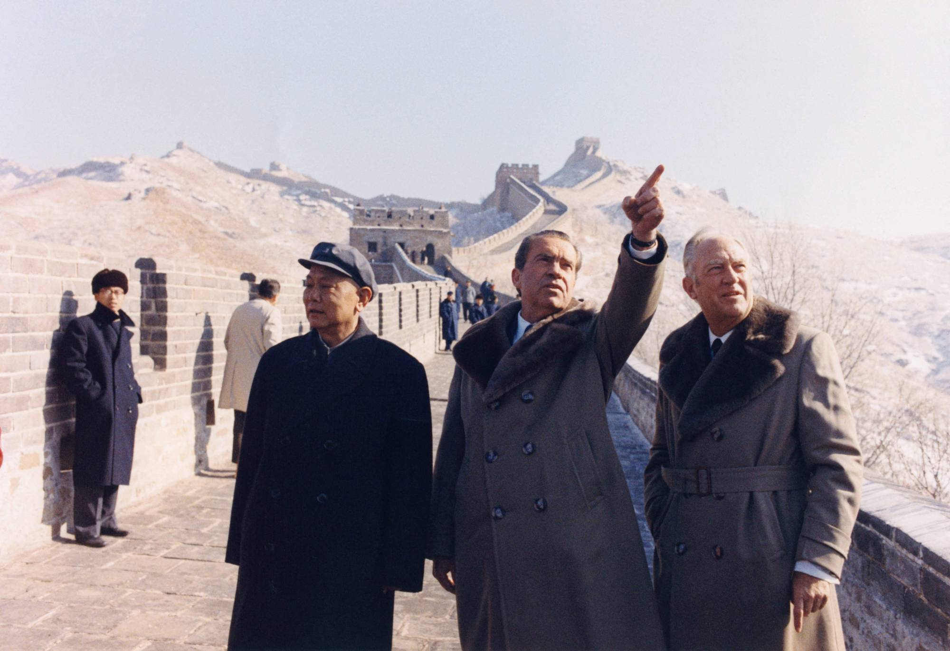
Richard Nixon
Great Wall of China

Slide 238
FINIS

